Slide 1
Khatiri Mohammed
Ordonnancement des tâches sur systèmes multi-coeurs hétérogènes
Thèse en Co-tutelle
France-UGA : Denis Trystram
Maroc-OUJDA : El Mostafa Daoudi

Slide 2
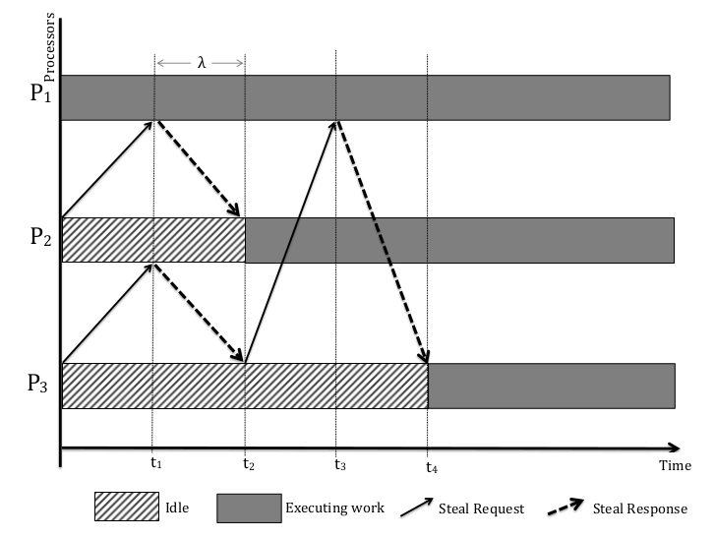


Work Stealing With Communication
[1] - M. Tchiboukdjian et All
Without communication :
Our Result : Nicola, Denis and Frederic
(submitted in TOPC journal)
With communication ( Latency : λ ) :

Slide 3
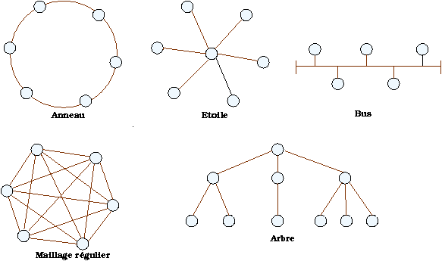
Work Stealing With Communication
This work forms the basis of incoming studies on more
complex hierarchical topologies :
    Communication cost inside clusters is small
    Communication cost outside clusters is important

Slide 4
A dynamic load balancing problem in graph algorithms on GPUs
(PageRanke)
Current work with Erik Saul (UNCC charlotte US) and Denis :
  Work Stealing on GPUs :
    Put all tasks on different GPUs.
    Work Stealing on GPUs using the indices instead of tasks.
    PageRank as a problem (product Matrix Vector)

